Slide 1
Extract and Explore
REDCap + R Workshop
R/Medicine 2024

Slide 2
The REDCapR Package Demo

Slide 3
Follow Along
Open the 01a_redcapr.qmd file in the exercises folder if you would like to follow along. Or simply watch Will’s presentation.

Slide 4
REDCapTidieR

Slide 5

REDCapTidieR
Makes it easy to import any REDCap project into R
Even if complex: longitudinal, repeated events or instruments, surveys, and/or data access groups (DAGs)
Based on REDCapR, makes its output tidier, which makes your work easier.
Is robust and efficient
Follows tidyverse software development lifecycle recommendations
97% test coverage
Extensive error checking with helpful error messages
Profiled and replaced tidyverse code with base R where we found bottlenecks
Notes:
…

Slide 6
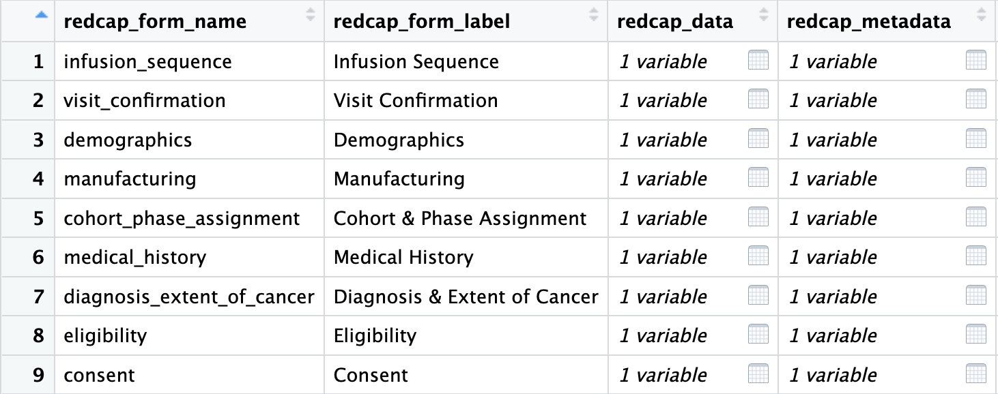
The REDCapTidieR Supertibble
Use read_redcap() to import a REDCap project into R
Returns a supertibble which contains data and metadata broken down by instrument
Notes:
The main function of REDCapTidieR is the read_redcap() function. This function takes a REDCap project’s URI and API key, and it returns a special object that we call the supertibble. The supertibble is a data frame or tibble that represents the whole REDCap project and contains nested tibbles that represent individual REDCap instruments. You get all the data and metadata in one place.
Here, you can see part of the supertibble from a CAR-T trial. Each row of the supertibble represents an instrument. You can see the name and label of the instrument. And then you have the `redcap_data` column that has all of these little table icons. By clicking on one of the table icons, you can drill down into individual data and metadata tibbles. This makes initial data exploration really easy.

Slide 7
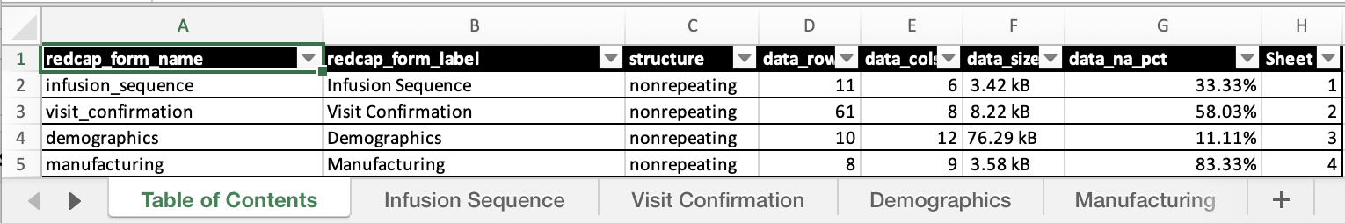
What can I do with the Supertibble?
Use bind_tibbles() or extract_tibble() to extract data from individual instruments
Use make_labelled() to add variable labels
Uses {labelled} to attach REDCap field labels to data columns
Use write_redcap_xlsx() to export to Excel
Collaborator-friendly! Supports labels
Notes:
So, what can you do with the Supertibble?
- You can extract data frames for individual instruments using either the bind_tibbles() or extract_tibble() function. Bind_tibbles() makes the data tibbles magically appear in the Environment, which is useful if you just want to get the REDCap data into R in the easiest possible way. Extract_tibble() extracts and returns an individual data tibble.
*** You can use make_labelled() to add variable labels. Adding human readable labels to cryptic variable names makes data exploration easier. The labels from from the Field Labels in the data entry forms.
*** And you can use write_redcap_xlsx() to export an entire REDCap project to Excel, which one tab per instrument. This is much nicer than the default REDCap export and is really handy for collaborating, and it supports labels so your collaborator can see the descriptions for each variable.

Slide 8
Your Turn
Open the 01b_extract_explore.qmd file in the exercises folder.
Read what it says and follow the instructions to complete the exercise.

Slide 9

Recap
REDCapR provides functions to interact with the REDCap API.
REDCapTidieR makes it easy to work with complex projects that contain longitudinal structure or repeated instruments into R.
The REDCapTidieR supertibble is a special data structure that represents a REDCap project. You can drill down into individual instruments.
Notes:
To recap what we covered up to this point, …

Slide 10
What else?

Slide 11
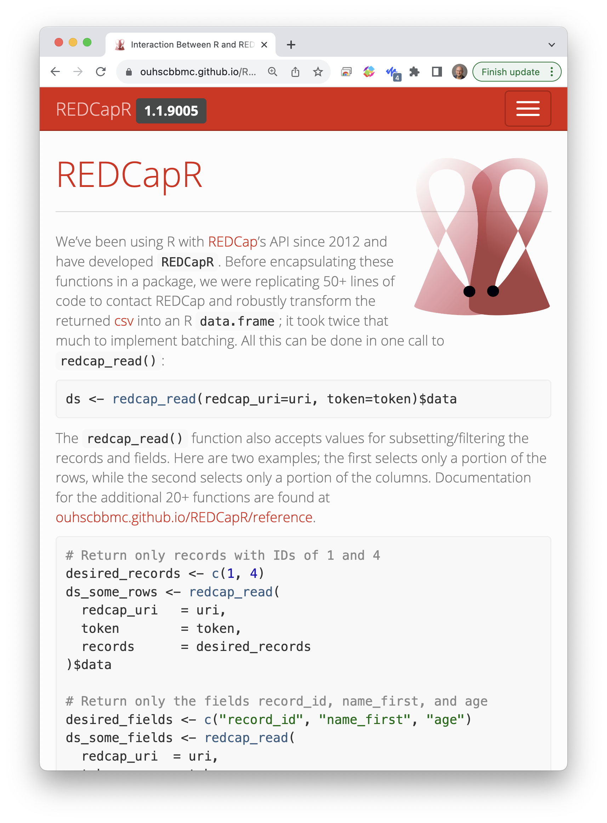
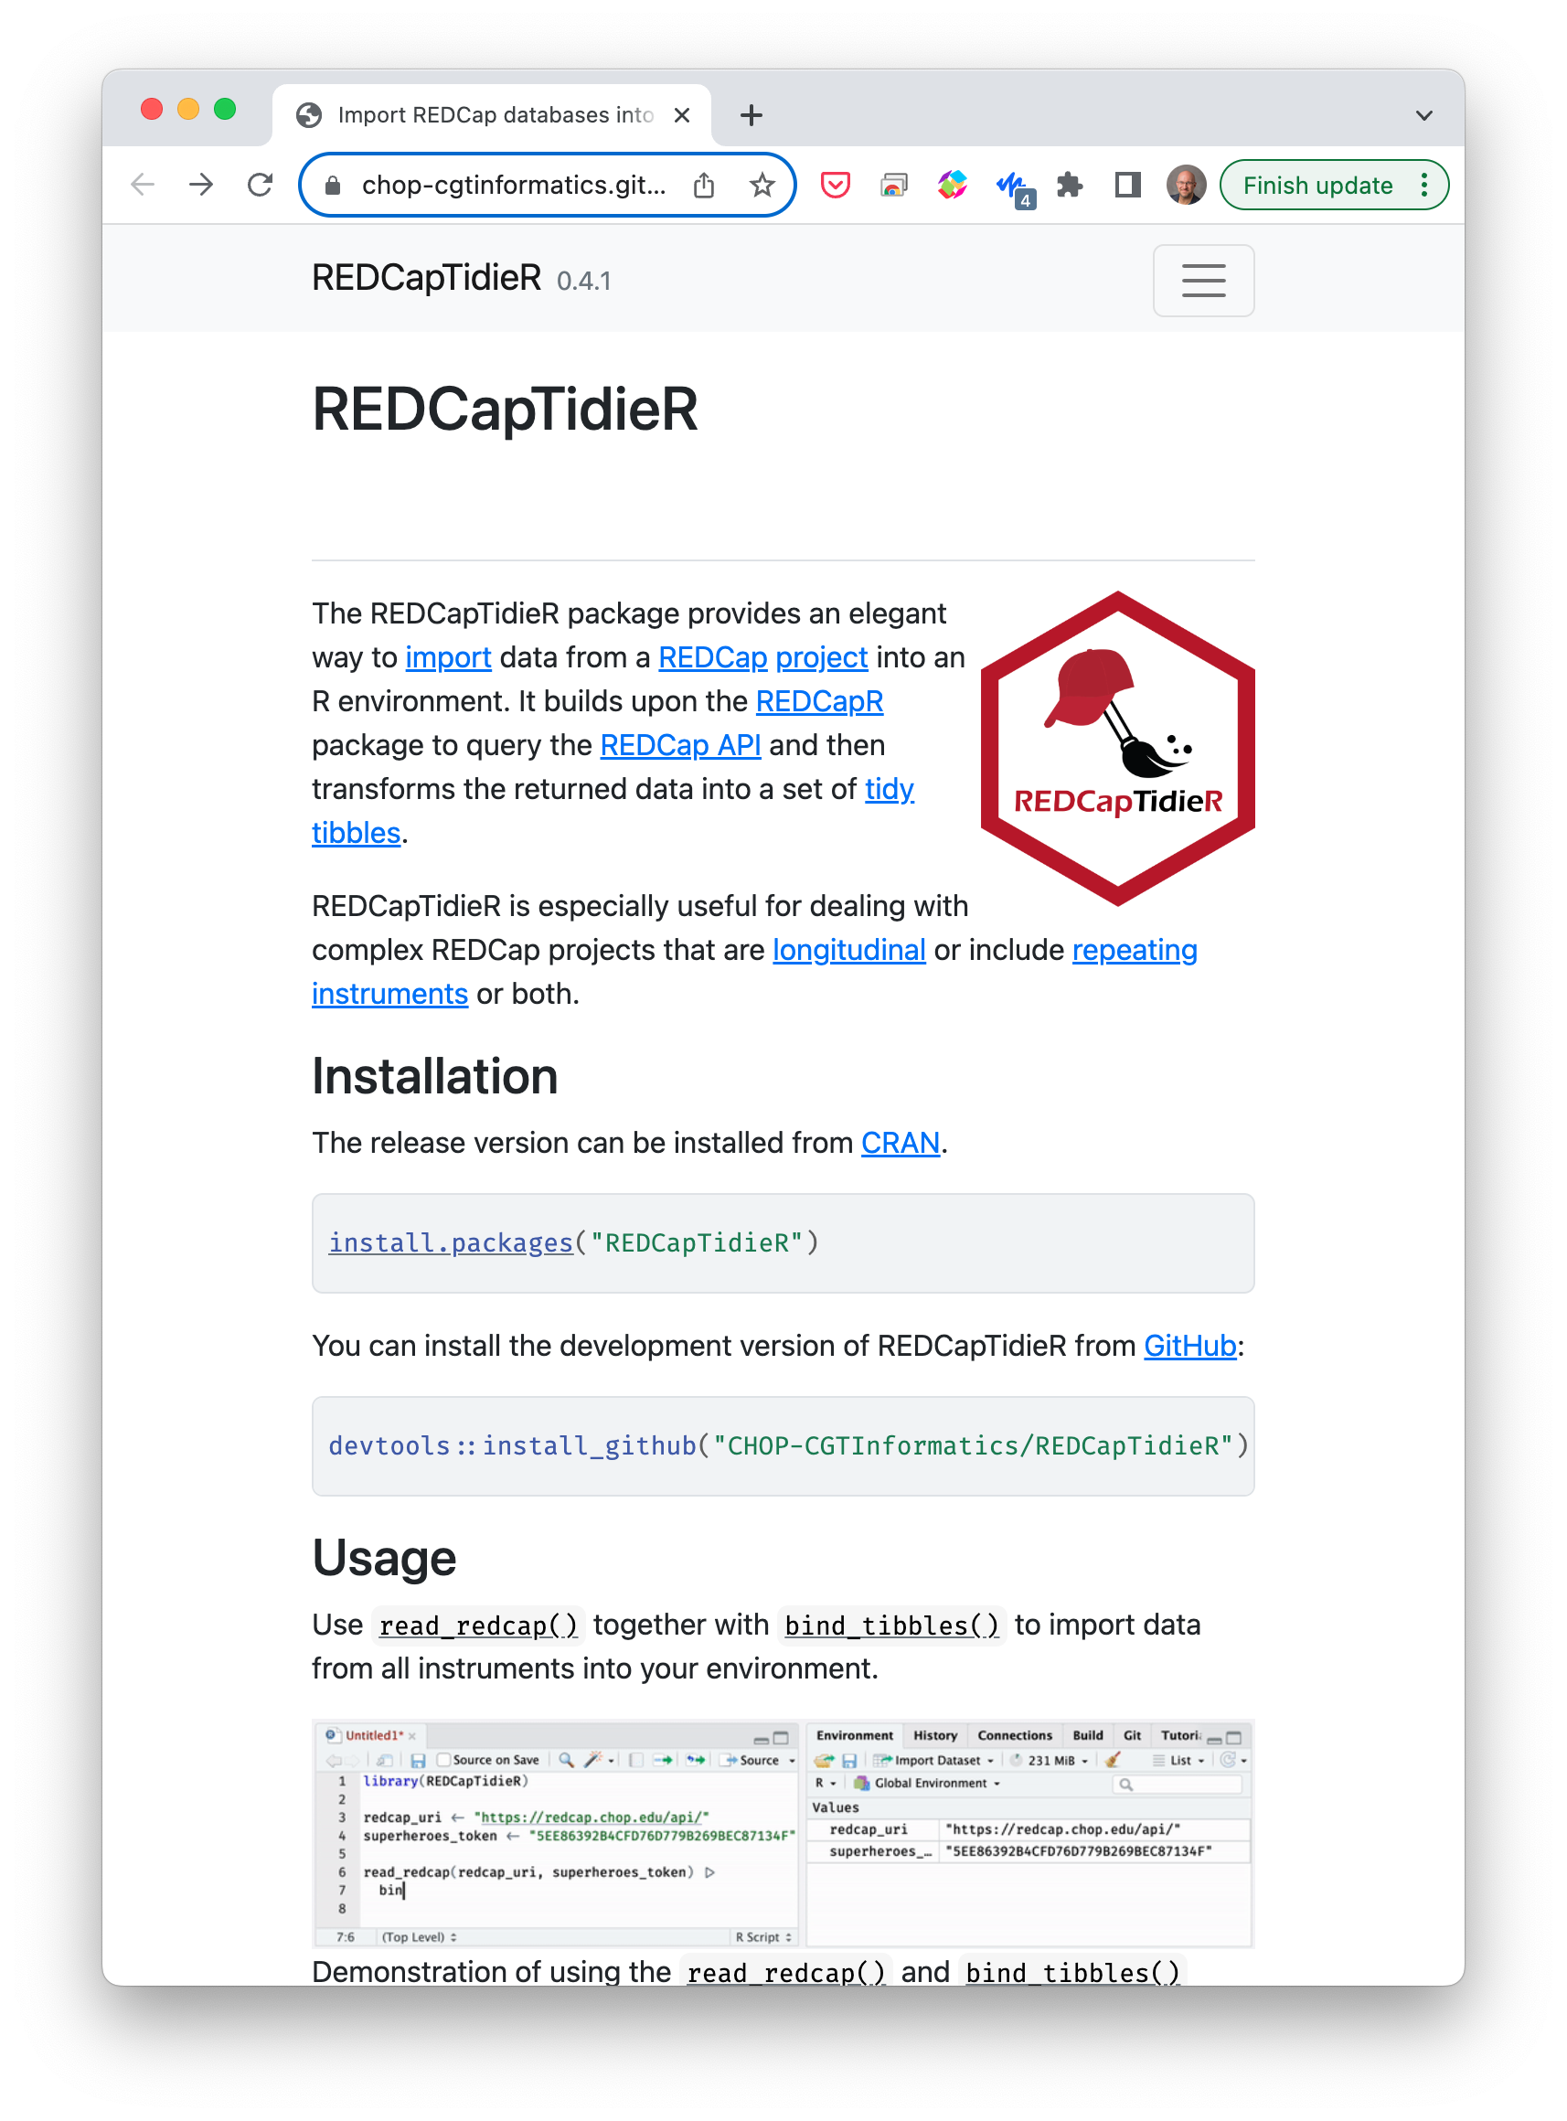
Notes:
Both the REDCapR and REDCapTidieR packages have extensive online documentation, including Getting Started tutorials and deeper dives into common workflows.

Slide 12


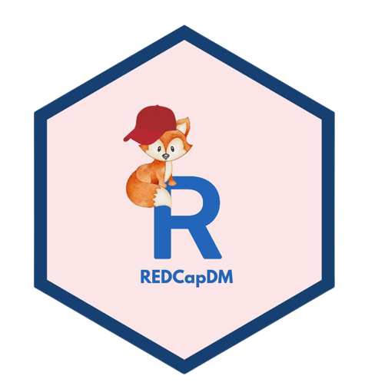

Notes:
There are a few additional packages for interacting with REDCap.
tidyREDCap makes it easy to create tables for choose-all or choose-one type questions. REDCapDM provides functions for REDCap database admins. Both of these are built on top of REDCapR.
redcapAPI is Vanderbilt’s package for interacting with the REDCap API, and so it’s an alternative for REDCapR.
REDCapExporter turns REDCap databases into R packages.

